Slide 1
Introduction – PETWALE
Member of Group 8:
Apurva
Niket
Pooja
Rohit
Sahil
Vibhuti

Slide 2

Problem Statement and Questions
Motivation:
In the last few years, the adoption rate of pets in the United States has increased significantly (pet adoption stats). Nowadays families are preferring to have pets instead of kids (anyone watched Boss Baby – an animated movie??).
Considering this, a pet venture can be a good idea to start a business.
Study Limitation:
For the analysis purpose we are limiting our study related to Cats or Dogs as pets. We are not taking into account for other types of pets.
Problem Context:
“Petwale” is a new startup aiming to provide pets all over the US. They are planning to open multiple outlets across the states but in order to start the business, they would like to invest in one state in the beginning and then based on the response they would like to take next steps.
Analytics team of “Petwale” has following key questions to answer before they start their venture:
Location: Which state they should invest in first to begin their venture?
Pet: Whether they should start with Dogs or Cats?
Pet Popularity: Understand which pet (Cats or Dogs) is popular across the state?
Consumers: Like Number of Households (HH) in each state, Number HH owning pets, cats and dogs?
Opportunity Available: Which state has the potential of adopting pets ?

Slide 3
Dataset
Data Granularity:
The data contains state level information about the total households, households with Pets, household with Cats/Dogs and their corresponding proportion. In the data we have total 48 rows where each row represents 1 state*
Source: Cat vs Dog Popularity in the US
Variables in Data:
Variables | Description
Location | States in United States
State | 2 letter state code
Number of Households (in 1000) | Number of households in each state
Number of Pet Households (in 1000) | Number of households owning pets
Percentage of households with pets | Number of households owning pets/Number of households in each state
Dog Owning Households (1000s) | Number of households owning dog pets
Percentage of Dog Owners | Dog Owning Households (1000s)/Number of Households (in 1000)
Mean Number of Dogs per household | Dog Population (in 1000)/Dog Owning Households (1000s)
Dog Population (in 1000) | Total Dogs population in each state
Percentage of Cat Owners | Cat Owning Households/Number of Households (in 1000)
Cat Owning Households | Number of households owning cat pets
Mean Number of Cats | Cats Population (in 1000)/Cats Owning Households (1000s)
Cats Population | Total Dogs population in each state
*Removed state “District of Columbia” as it has only 287 HH’s, which is significantly low as compared to other states HH’s count.

Slide 4
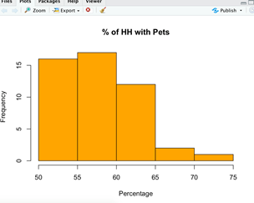
Descriptive Statistics (1/2)
Cats vs. Dogs Comparison
From the preliminary comparison analysis between Cats and Dogs across all the states, we see that:
Number of HH with Dogs are higher than Cats
But, the Total Population of Cats is more than Dogs
Comparison of avg. number of Dogs or Cats per HH across the States
From the data and histogram* we can say that:
Avg. Cats varied from 1.7 to 2.6, whereas Dogs varied from 1.1 to 2.1
Major proportion of States (42 out of 48) have avg. no. of Cats between 1.8 to 2.2
Whereas, 32 States have avg. no. of Dogs between 1.2 to 1.6
We can conclude that per HH there are more number of Cats than Dogs across the United States.
Comparison of % of HH’s with Pets, Cats and Dogs
From the histograms* we can observe that:
33 States out of 48 have 50-60% of HH’s with Pets
37 Sates have 30-45% of HH’s with Dogs
40 States have 25-35% of HH with Cats
From this we can confirm that the Dogs are more popular among the HH’s across all the States.
*In dual comparison histograms, some data has been overlapped.

Slide 5
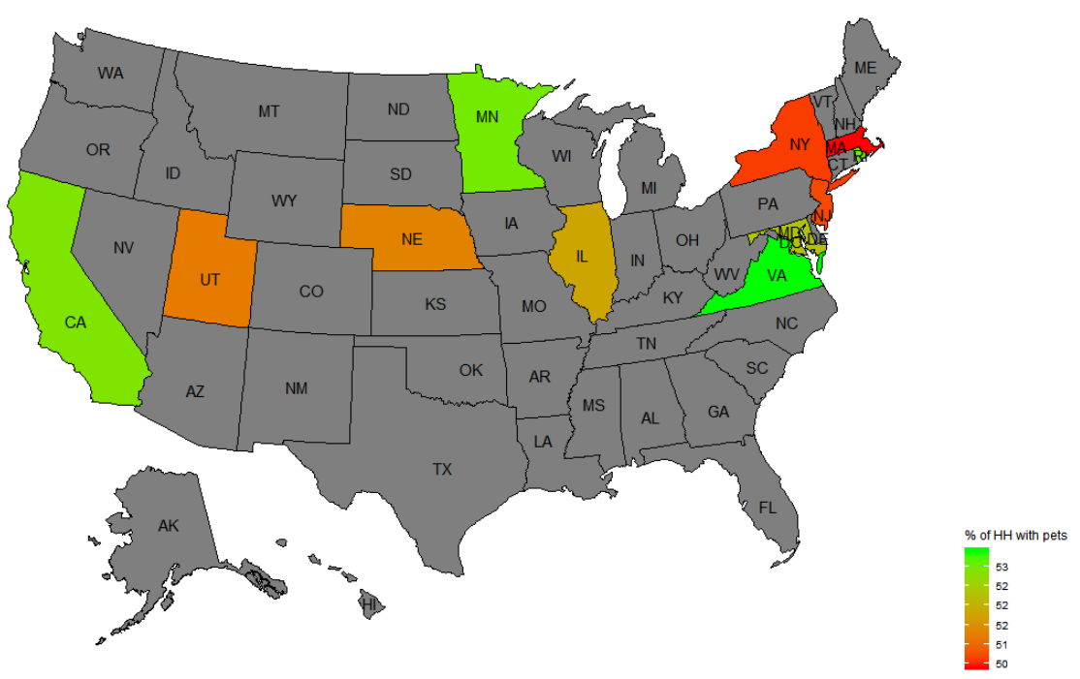
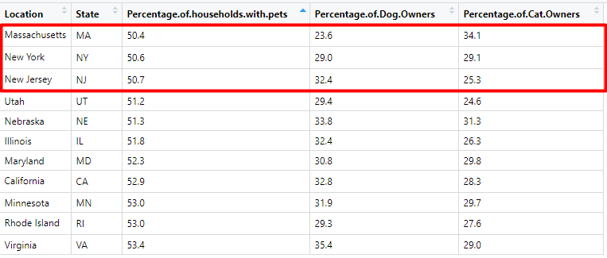
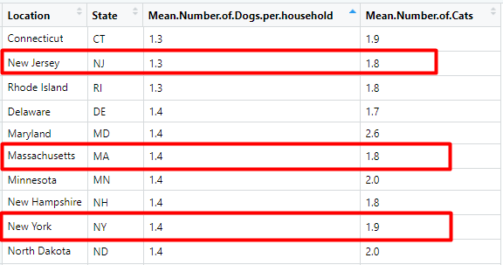
Descriptive Statistics (2/2)
So far, we analyzed the data at overall level including all the states. Now, we would like to do some analysis and comparison at State level.
Bottom 10 States with the least % of HH’s having Pets:
From the below charts, we can observe that states like: Massachusetts, New York and New Jersey have least % of HH with Pets and Dogs.
2. Bottom 10 States with average number of Dogs and Cats per HH:
In the data table, we are comparing the states with the least avg. number of Cats vs. Dogs per HH.
Overall, we observe that the states like - Massachusetts, New York and New Jersey have both low % of HH with Pets (Cats and Dog) and Avg. number of Cats & Dogs per HH.

Slide 6
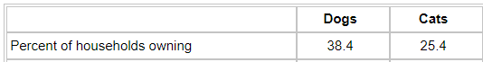
Statistical Inference(1/3)
Now in the below slides we are going to look at the real business of statistics. Although the heading – “Statistical Inference” may looks bit scary, but in a nutshell, what is does is to save our time and money by telling - Which pet to sell – Cats or Dogs?
From the AVMA, we understood the following about the population of Cats and Dogs:
☺ Source: American Veterinary Medical Association ☺
Now, we would like to verify how close our sample data is to the information mentioned above and look at some other attributes:
Terminology:
Interval Range : Let say, if we obtain 100 different samples with same attributes, then we would like to know what is the range of values shown by 95 samples and how close are that to above values of AVMA.
1.
Conclusion: From above intervals, we can observe that although the range of interval is same across Cats and Dogs but interval of % of HH with Dogs is higher than Cats.
2.
Conclusion: From the interval we can conclude that if we look at the across all the states, the number of HH with Dogs are more than the Cats.
Attributes | Result from Sample Data | Interval Range
Total % of HH with Dogs | 36% | 22.9% to 50.1%
Total % of HH with Cats | 30% | 17.3% to 43.3%
Attributes | Interval Range
Mean of the difference b/w - # of HH with Dogs & Cats | 78 to 226

Slide 7

Statistical Inference(2/3)
Terminology:
Interval Range : Let say, if we obtain 100 different samples with same attributes, then we would like to know what is the range of values shown by 95 samples and how close are that to population value.
3.
Conclusion: From we can observe that the sample average number of Cats per HH is higher than Dogs and its corresponding interval is also higher.
4.
Conclusion: As the above CI is completely negative, the mean number of Dogs per HH is less than the Cats.
Attributes | Sample Mean | Interval Range
Avg. number of Dogs per HH across all the states | 1.59 | 1.54 to 1.65
Avg. number of Cats per HH across all the states | 2.04 | 1.99 to 2.11
Attributes | Sample Mean | Interval Range
Mean of the difference b/w - No. of Dogs and Cats per HH | 0.45 | -0.50 to -0.038

Slide 8

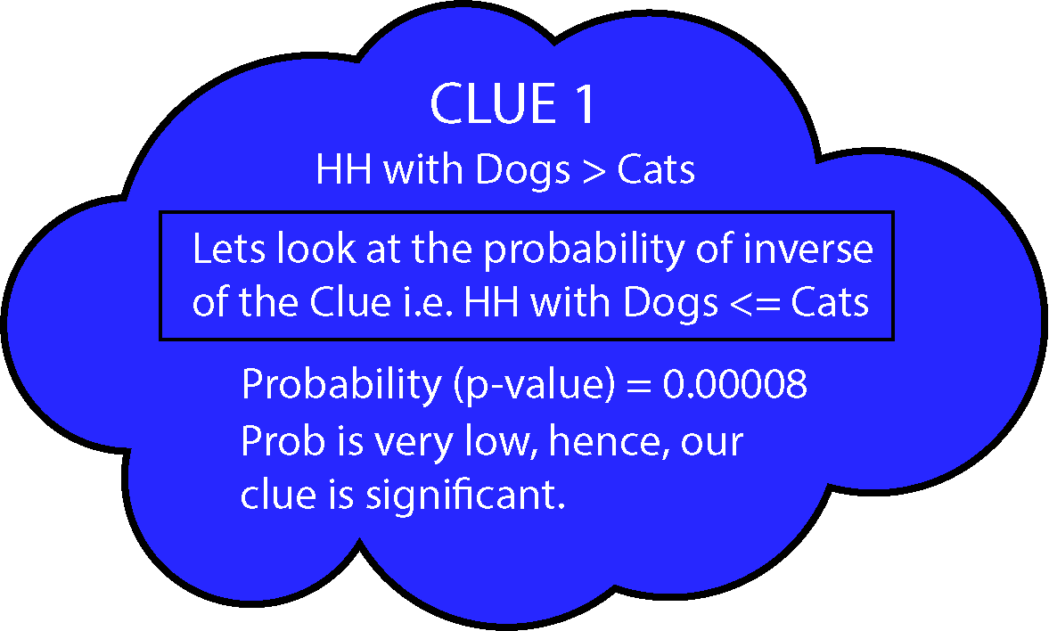
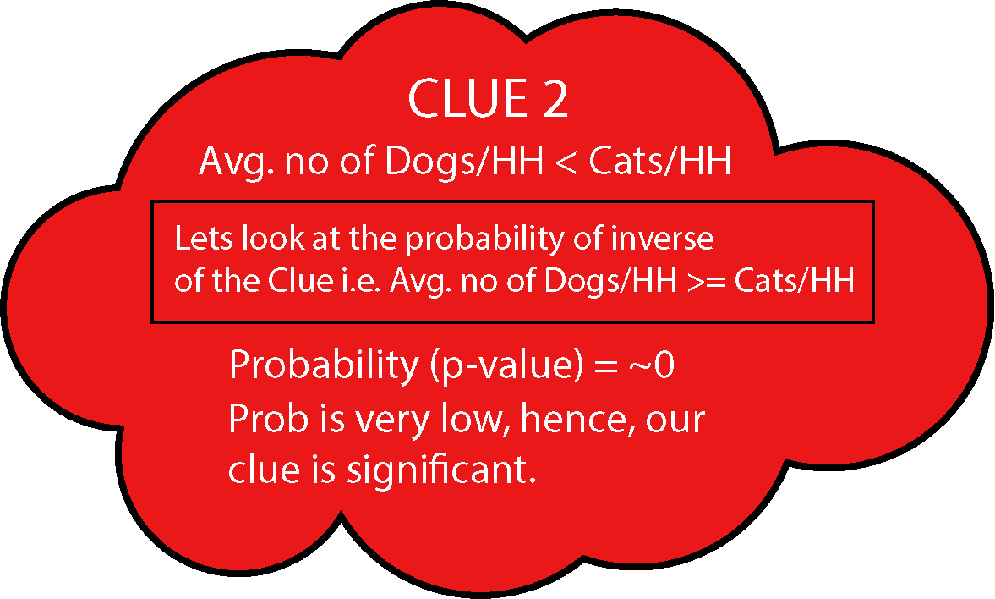

Statistical Inference(3/3)
Lets do some guessing – Sherlock Holmes Style?
What we know :
% of HH with Dogs is higher than Cats.
Average number of Dogs per HH is less than the Cats.
Interpretation:
From above analysis, we notice that although the Dogs are more popular in the HH’s but the avg. number of Cats per HH is higher. There could be various reasons for having avg. of Cats being higher than Dogs per HH, which could be:
In actual, people like to have more than one cat at home whereas in case of Dogs they prefer only 1
Life span of pet cats and dogs could be another factor. Study shows that avg. lifespan of Indoor Cats is 13 to 17 years (Source) whereas for Dogs its 8 to 11 years (Source)
Recommendation:
Therefore, considering all the factors and results obtained above we recommended to go ahead with selling the Dogs in the state.

Slide 9
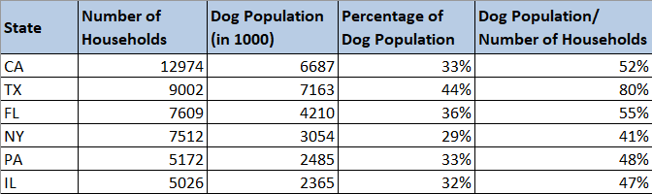
Final Analysis (1/2)
Since from previous analysis we came to know that dog is the pet to start business (compared to cats), we will now target which state to start “Petwale” venture with. To do so we are considering these factors to answer our question:
Total Number of Households
Dog Population
Dog Households
Mean % of Dog Population
Above 4 factors will help us know:
What is the population of Dogs with respect to total HH in that state?
Which state is still left with potential to adopt Dogs as pet ?
Steps:
1. Below table shows the top 6 states with the highest Number of Households. To start our analysis we select the state, and take Percentage of Dog Population by Total HH.

Slide 10
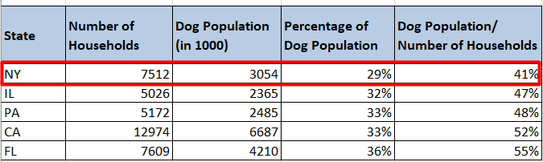

Final Analysis (2/2)
2. Now, we will be looking at the states with Percentage of Dog Population below the overall value of 36.51%. We get following states :
3. Now as seen from the above table state New York is the least with Percentage of Dog Population/Total HH i.e. 29, it is very less. This also depicts that 71% of dog population is yet to be adopted in New York.
4. If we look at the average % of dog population across the New York households, it again depicts the least (from the list of top states) with just 41%. This depicts the open market potential in New York to start “Petwale” venture.
Finally, after the whole analysis and result, we can conclude that New York state is the state with great market potential and ideal to start because of the demand and trend towards adoption of dogs as pets all over the US.
PETWALE - NY

